Slide 1
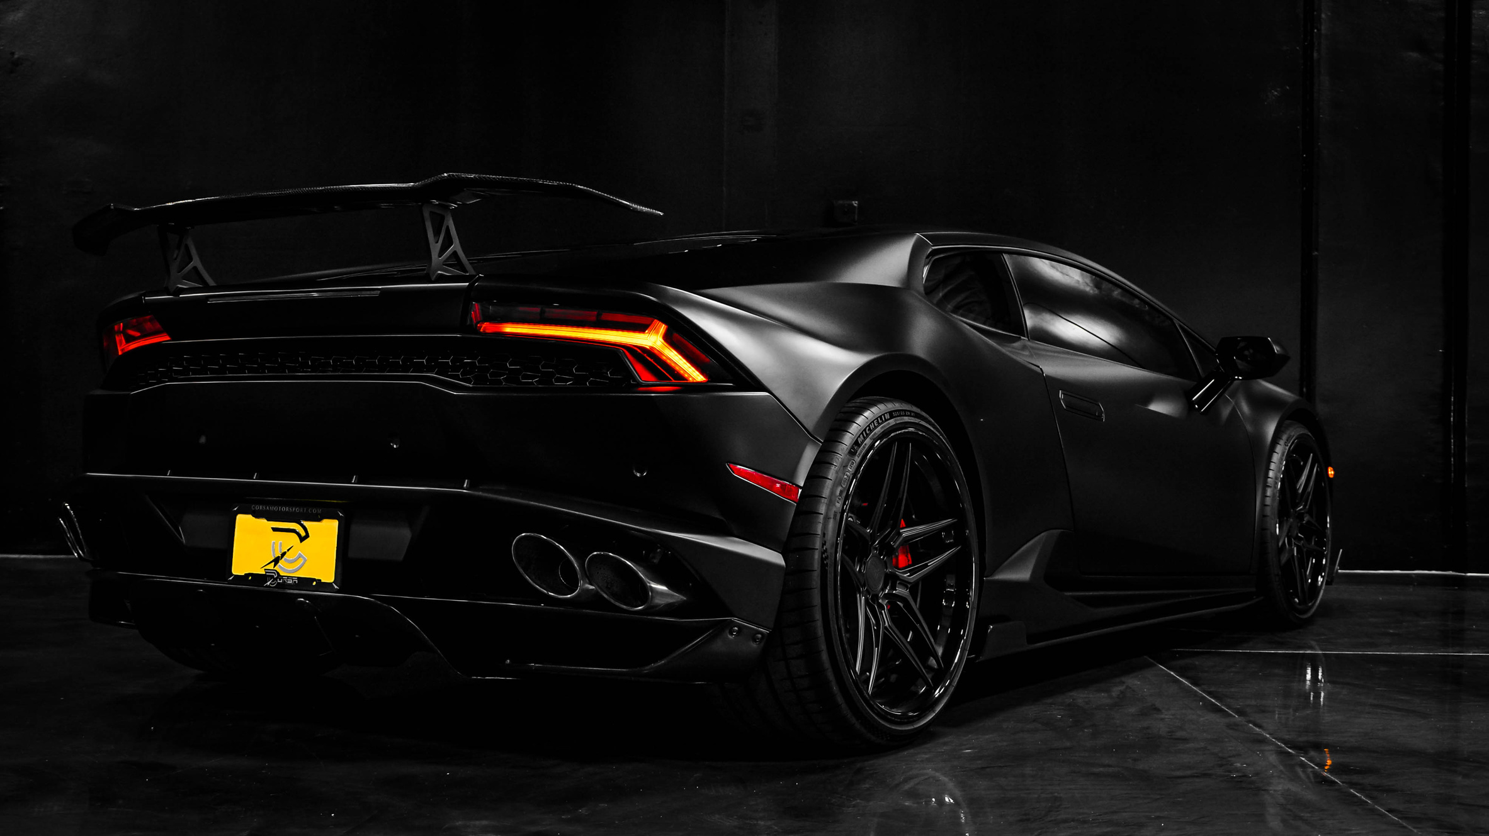




CAR SAFETY
Safety on the road, peace of mind for life.
Let’s GO

Slide 2
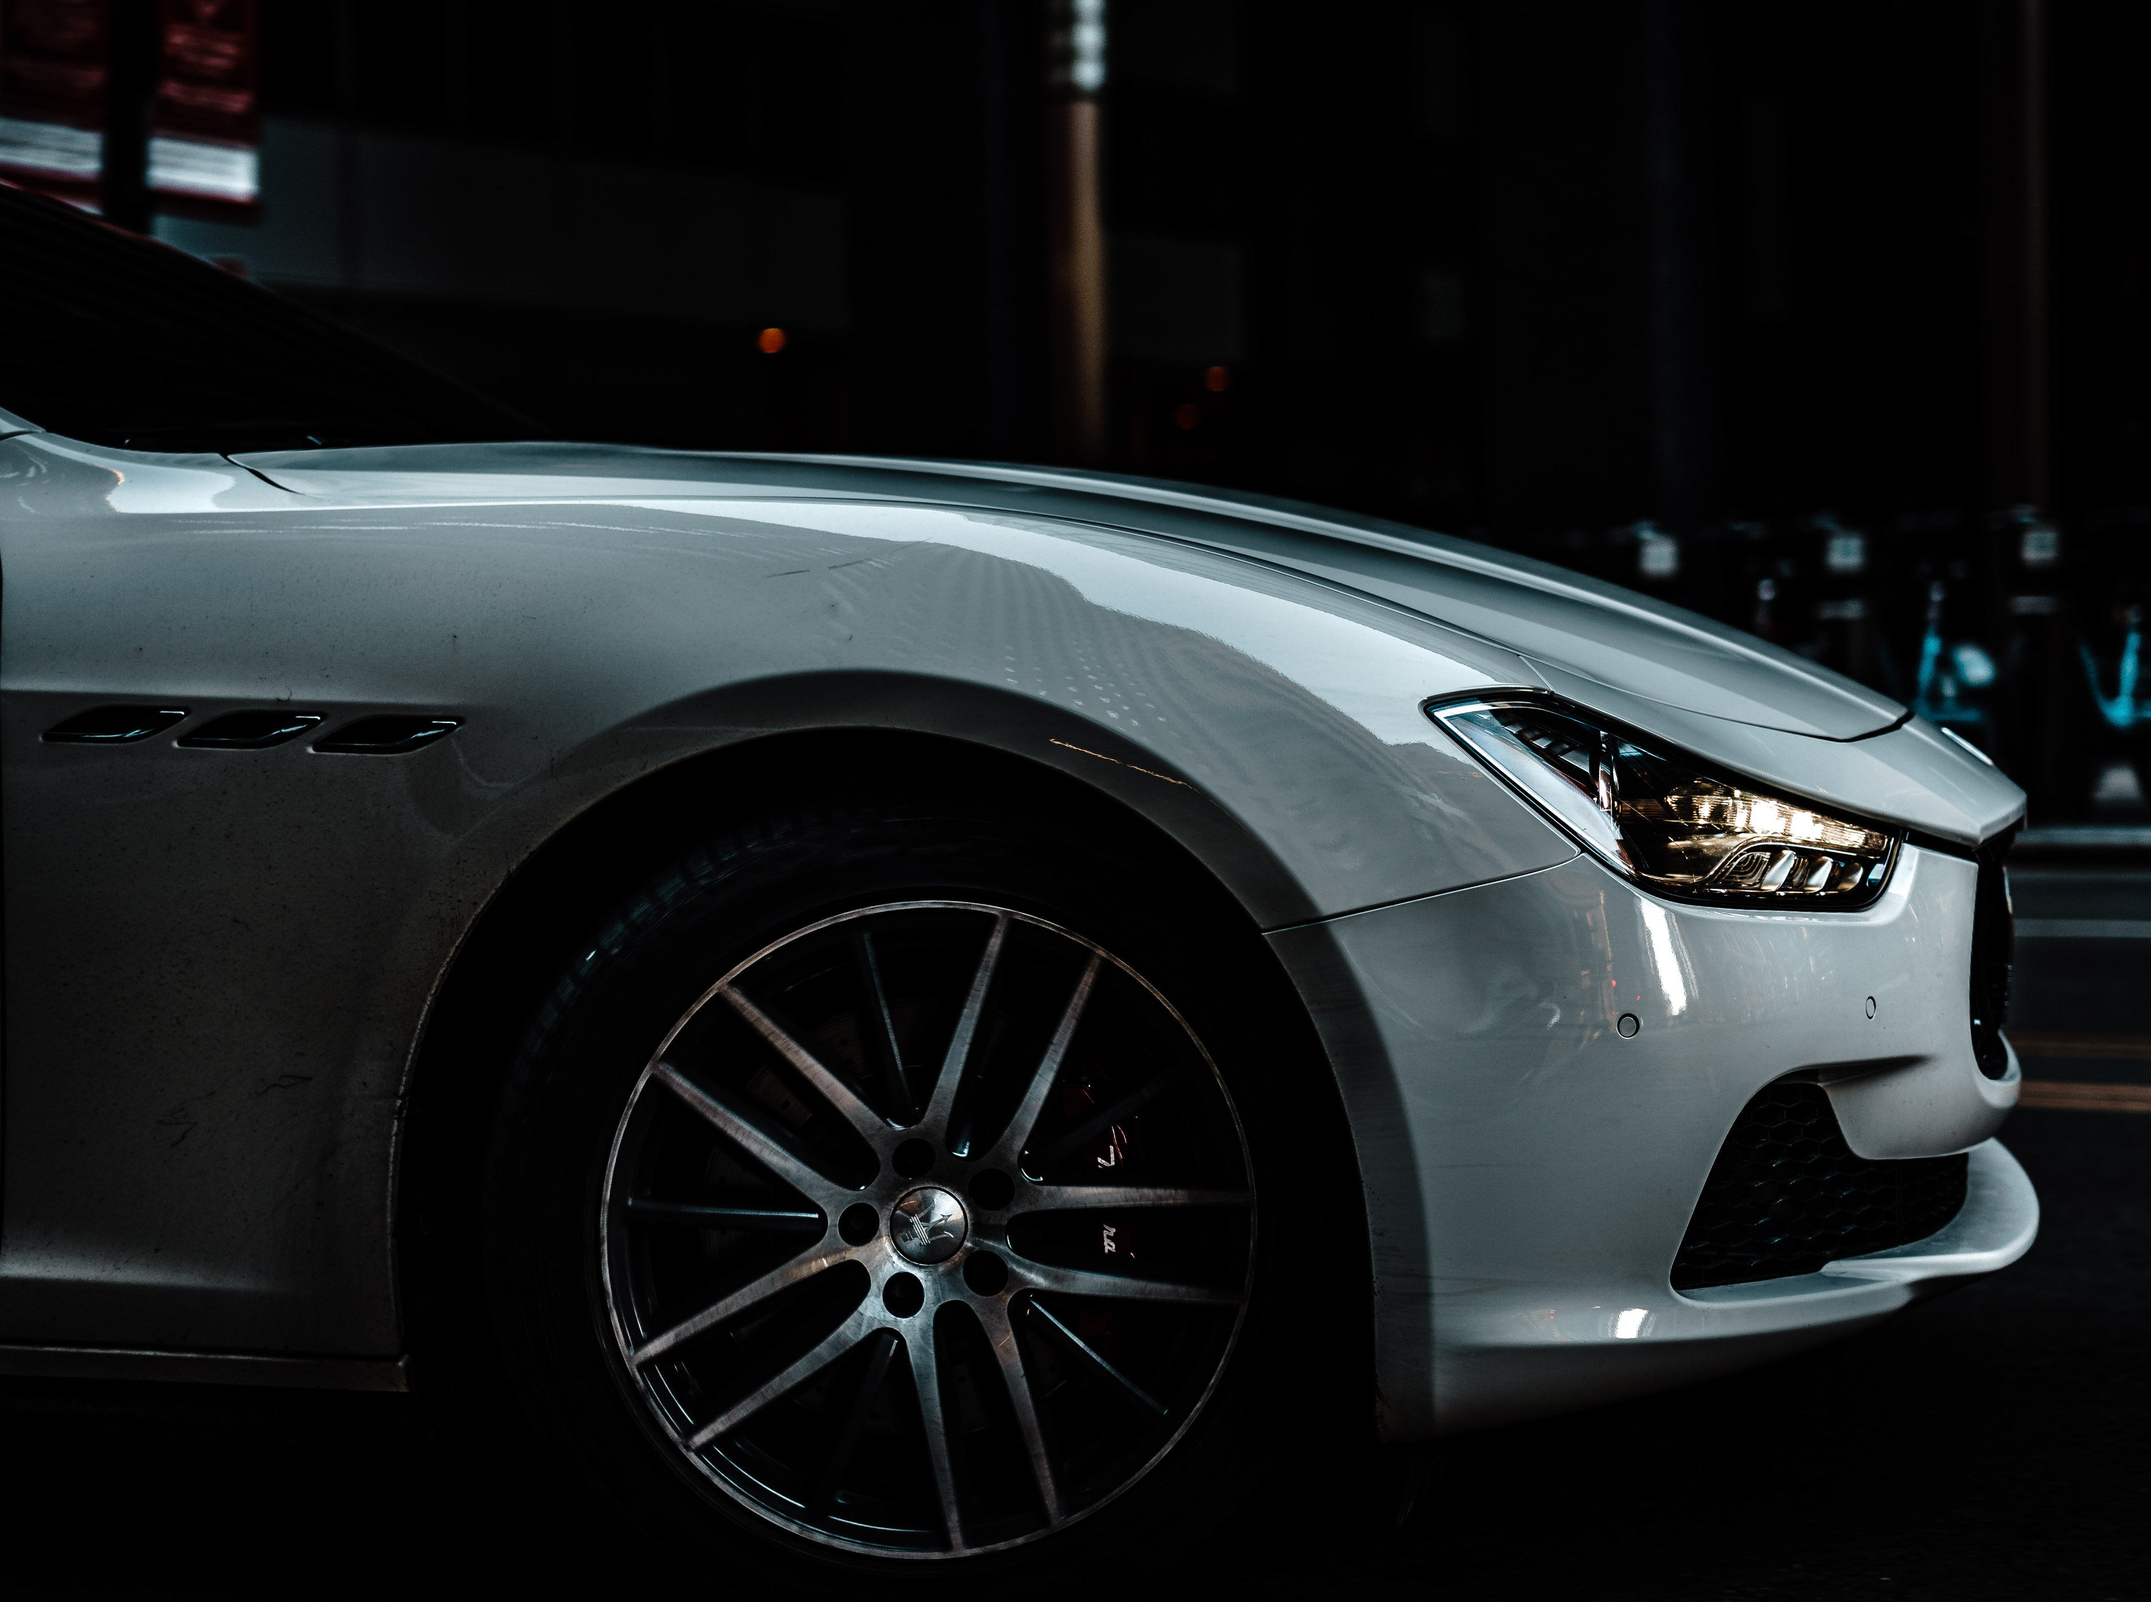



WHAT IS
THE PROBLEM
The main problem is reduced visibility on roads due to natural phenomena like fog
Fog and Low Visibility: Thick fog significantly reduces visibility, making it difficult for drivers to see other vehicles, road signs, and obstacles.
Delayed Reaction Times : When visibility is impaired, drivers have less time to react to sudden changes, such as another car braking or an obstacle on the road

Slide 3

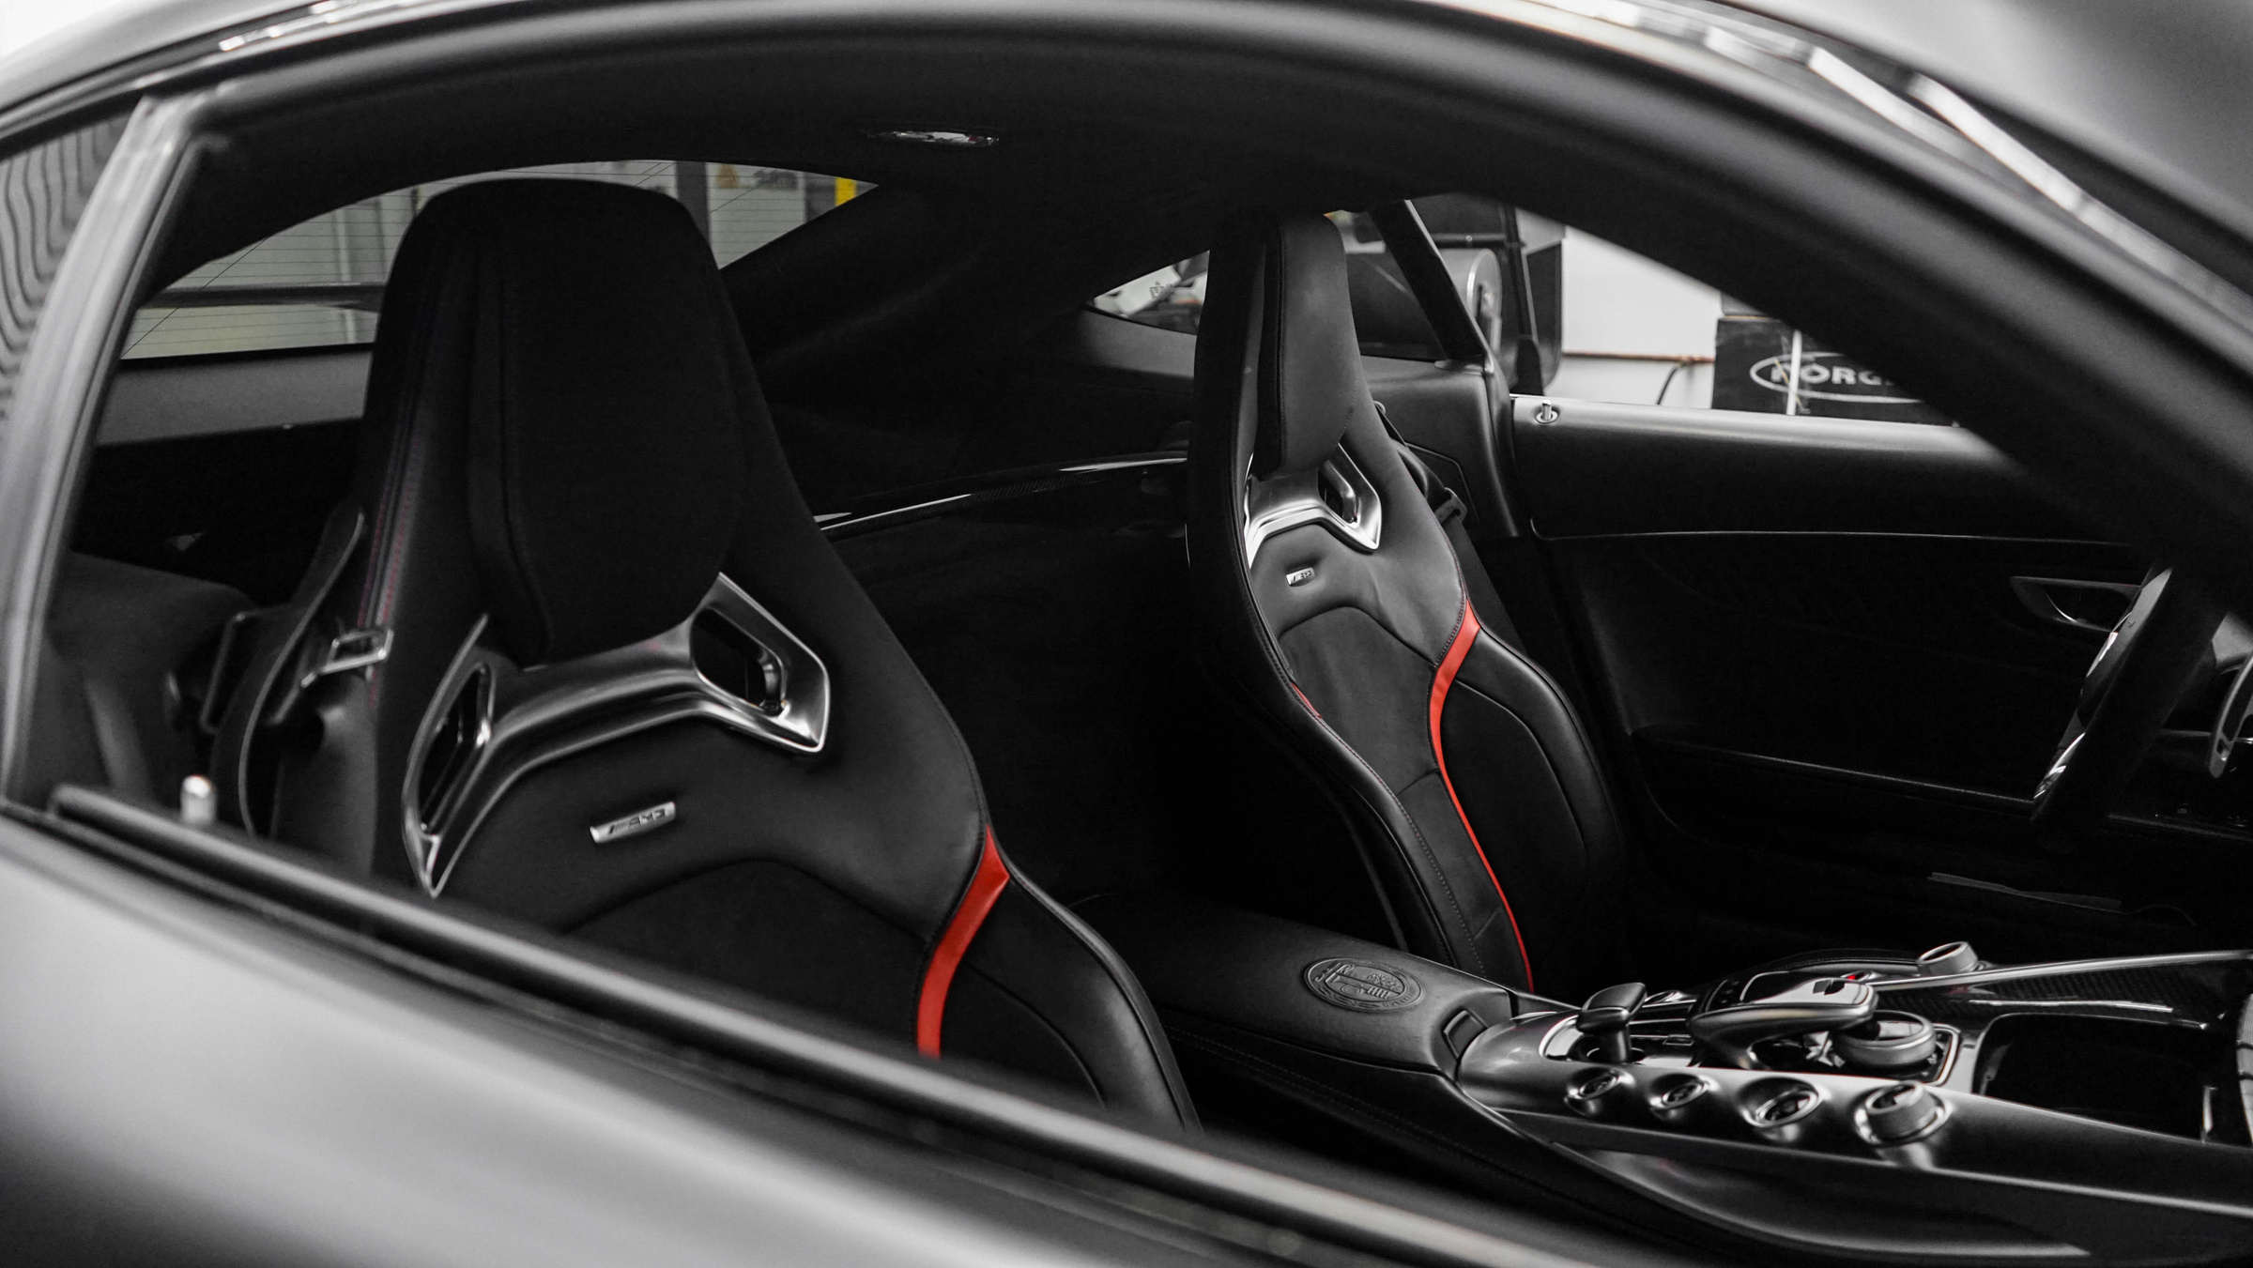
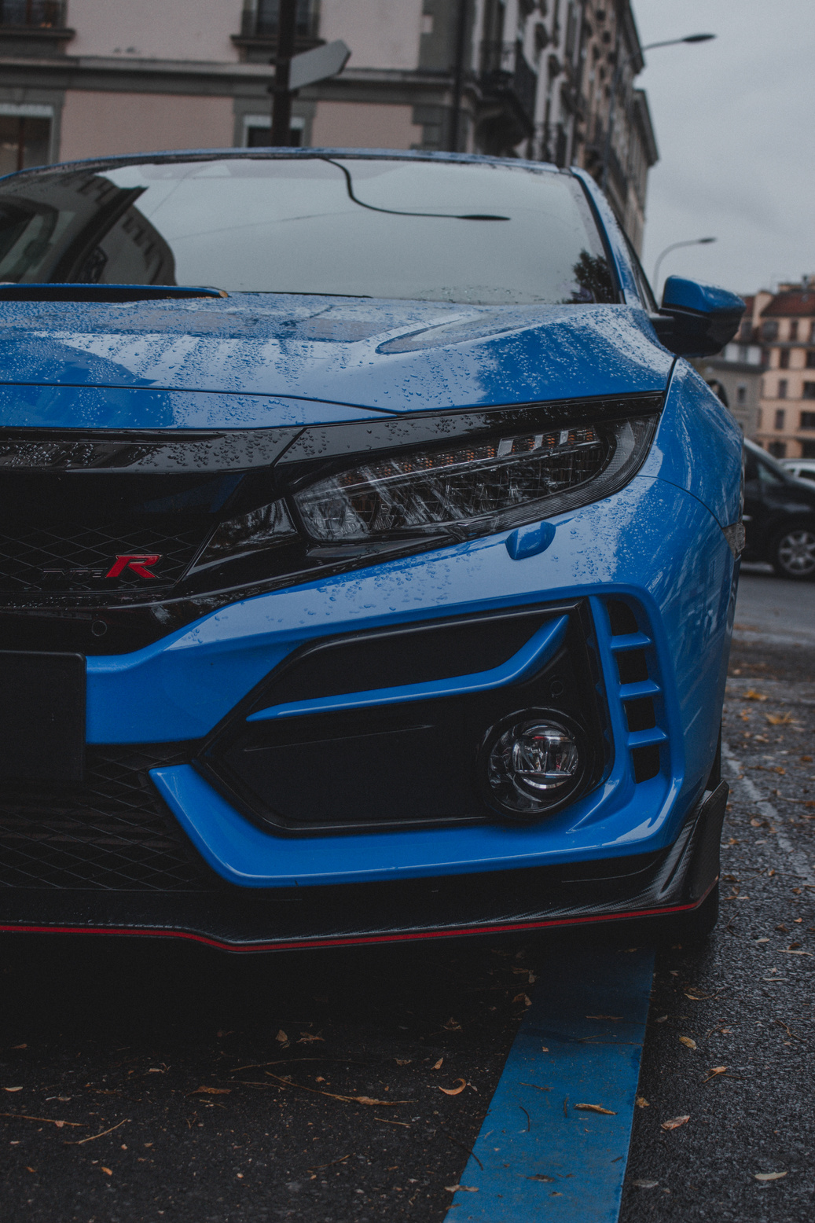

OUR PLANS TO INCREASE SAFETY
Stay Connected and Secure : Advanced vehicle-to-vehicle communication for accident alerts in the cases of foggy conditions and low visibility , Safeguarding a 5 km zone using Radio Signals
Saving People Life
Saving More severe Accidents
Helps in improving roads
Help the authorization to take action fast

Slide 4

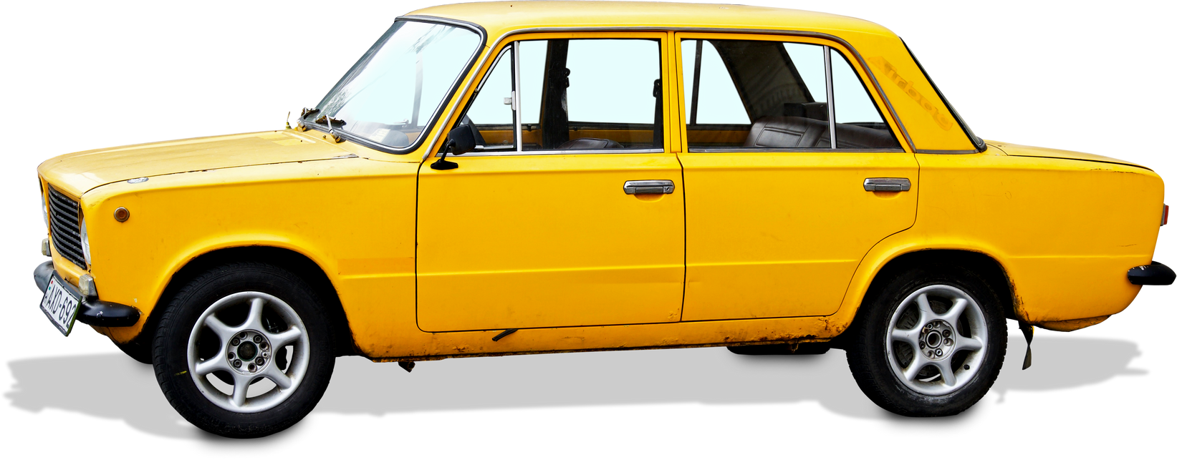
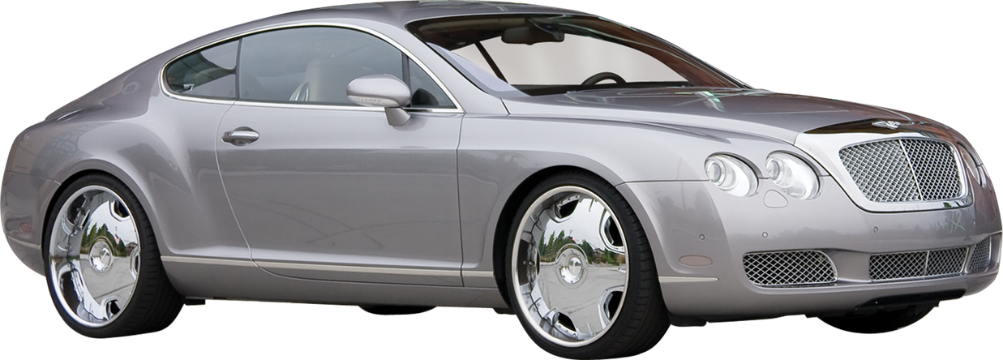
OUR STRATEGY
01
RESEARCH & ANALYSIS: STUDY ACCIDENT CAUSES AND EXISTING ALERT SYSTEMS.
02
TECHNOLOGY STACK: SELECT SENSORS, COMMUNICATION PROTOCOLS, AND DEVELOPMENT PLATFORMS.
03
DEVELOPMENT: BUILD THE DETECTION AND ALERT SYSTEM, INCLUDING IN THE CAR ITSELF
04
TESTING: CONDUCT SIMULATIONS AND FIELD TESTS, REFINE BASED ON FEEDBACK
05
DEPLOYMENT: ROLL OUT IN HIGH-RISK AREAS, MONITOR AND OPTIMIZE PERFORMANCE

Slide 5




STATISTICS
PRIMARY AFFECTED
01
This involves the people who were directly affected due to such accidents and suffered injuries
Low visibility in road travel caused due to fog and pollution has resulted in multiple accidents across the glob and has contributed significantly in the in the total road accidents . This is something that has affected multiple lives and also resulted in fatalities . Taking USA statistics on fog related
road accidents
74%
02
SECONDARY CONCERNS
Damage caused due to such accidents also play a role in the impact of such cases and affect the people involved ie: the owners of the vehicles and goods being transported
30%
+8.4K
2.2%
03
IN A BROADER VIEW
People will find road travel and transport safer. The damages will be reduced and people will be saved .
DEATHS DUE TO FOG RELATED ROAD ACCIDENTS BETWEEN 2001-21

Slide 6
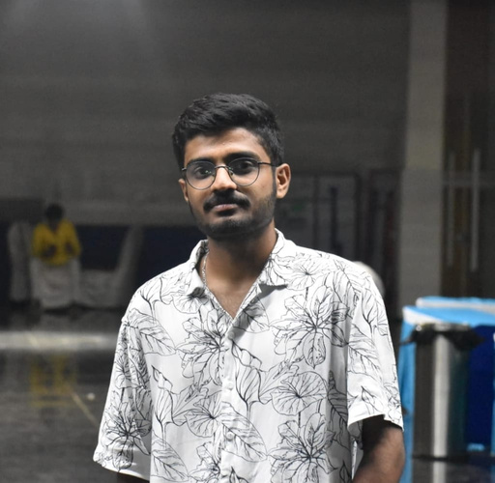
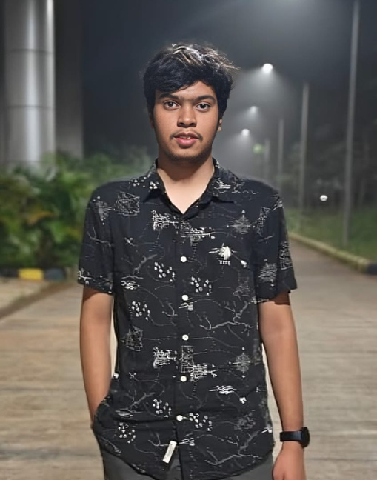
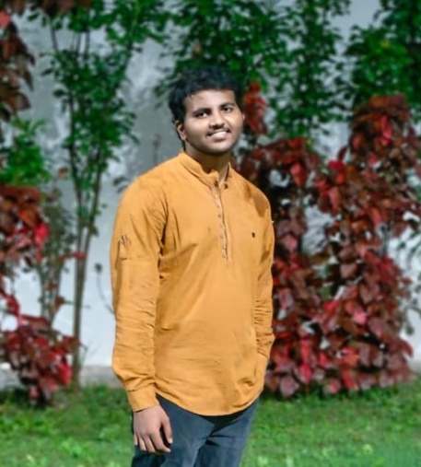
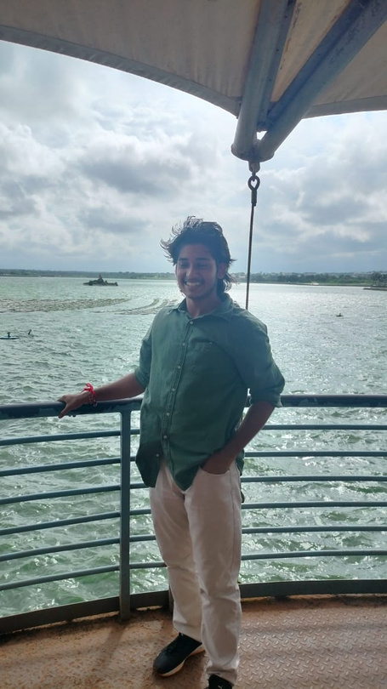
TEAM
OUR
ROHAN GOWDA
RACHIT YADAV
SHARANPRAKASH R KASBAG
SUSHANT SHARMA

Slide 7

THANK YOU
End of Slide

